Slide 1
Cyber, Risk and Human Rights LAWS8077 – CYBER LAW
Dr Damian Clifford damian.clifford@anu.edu.au

Slide 2
SEMINAR OVERVIEW
Recap
Cyber security and risk
Architecture – ‘Code’ is the equivalent
Q&A with Ivo

Slide 3
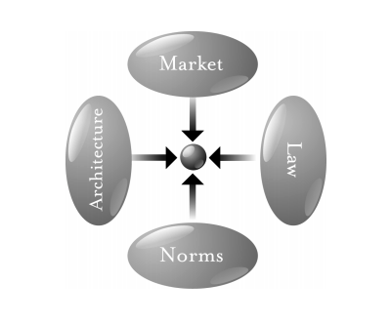
Code is law: The Pathetic Dot and Modalities
Norms – Cyberspace has its own ‘netiquette’
Market – Market constrains in cyberspace
Architecture – ‘Code’ is the equivalent
Law – Direct regulation of cyberspace
Law also indirectly regulates the other 3 modalities
It is necessary to then find the best mix of modalities
Modern regulation will often be a mix of direct and indirect strategies

Slide 4
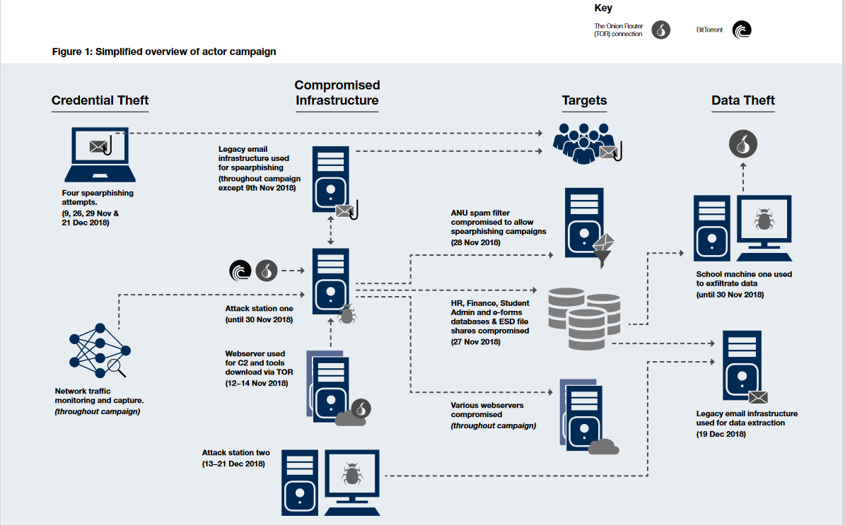
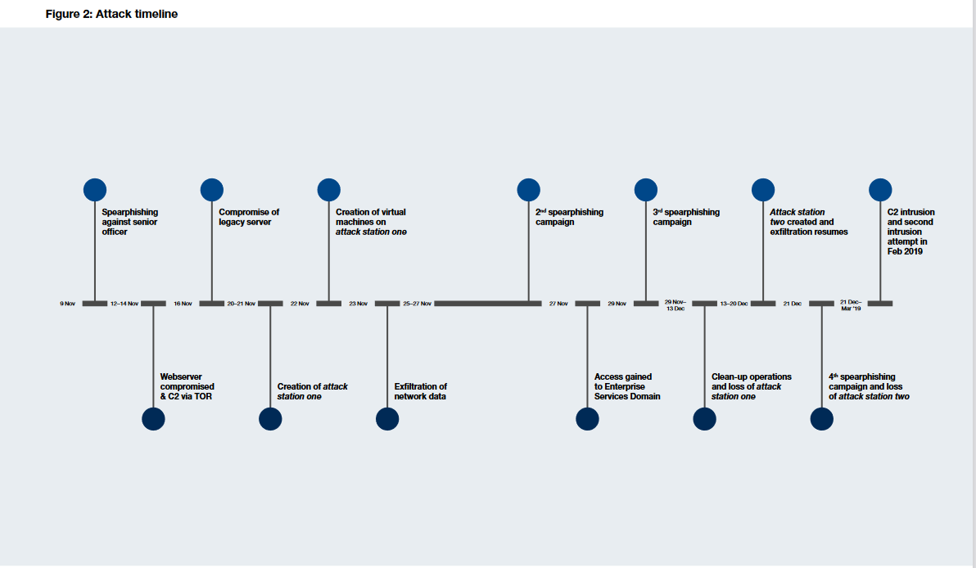
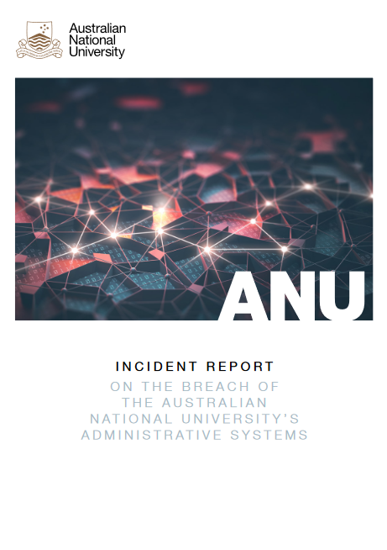
Cyber Security – Examples of attacks
ANU (2018): Spearfishing
Unauthorised access to the ANU network resulting in the breach of part of the network known as the Enterprise Systems Domain (ESD), which houses our human resources, financial management, student administration and enterprise e-forms systems.
Resulted in:
Credential theft
Compromised infrastructure
Data theft
Notes:
https://imagedepot.anu.edu.au/scapa/Website/SCAPA190209_Public_report_web_2.pdf

Slide 5
Some scary statistics
Australia’s Cyber Security Strategy 2020 (homeaffairs.gov.au)
‘Between 1 July 2019 and 30 June 2020, the ACSC responded to 2,266 cyber security incidents at a rate of almost six per day. This does not include other incidents referred to the police and support organisations. The true volume of malicious activity in Australia is likely to be much higher. According to one expert analysis, cyber incidents targeting small, medium and large Australian businesses can cost the economy up to $29 billion per year, or 1.9% of Australia’s gross domestic product (GDP). Further, it is estimated that a four week interruption to digital infrastructures resulting from a significant cyber incident would cost the economy $30 billion (1.5% of Australia’s Gross Domestic Product) and around 163,000 jobs.’

Slide 6
Some scary statistics
Australia’s Cyber Security Strategy 2020 (homeaffairs.gov.au)
‘The COVID-19 pandemic highlighted the evolving nature of cyber threats. Opportunistic cyber criminals quickly adapted their methods to take advantage of more Australians working, studying and connecting online. Between 10 and 26 March 2020, the ACSC received over 45 pandemic themed cybercrime and cyber security incident reports, with the Australian Competition and Consumer Commission’s (ACCC) Scamwatch receiving over 100 reports of COVID-19 themed scams. Campaigns were designed to distribute malicious software (malware) or harvest personal and financial information from unsuspecting Australians.’

Slide 7
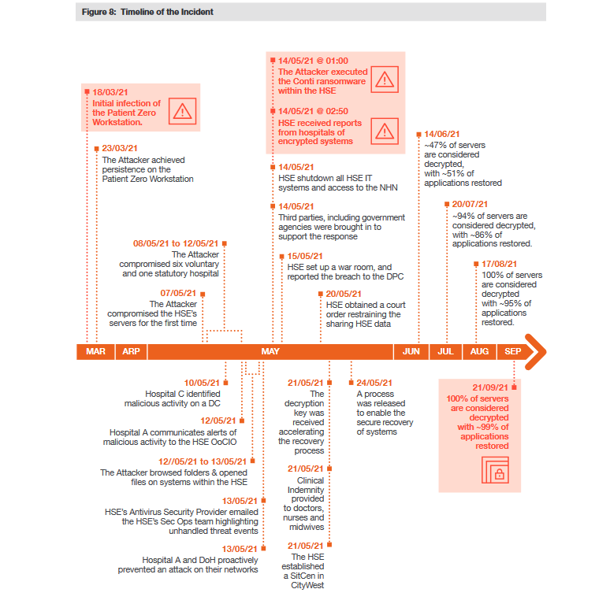
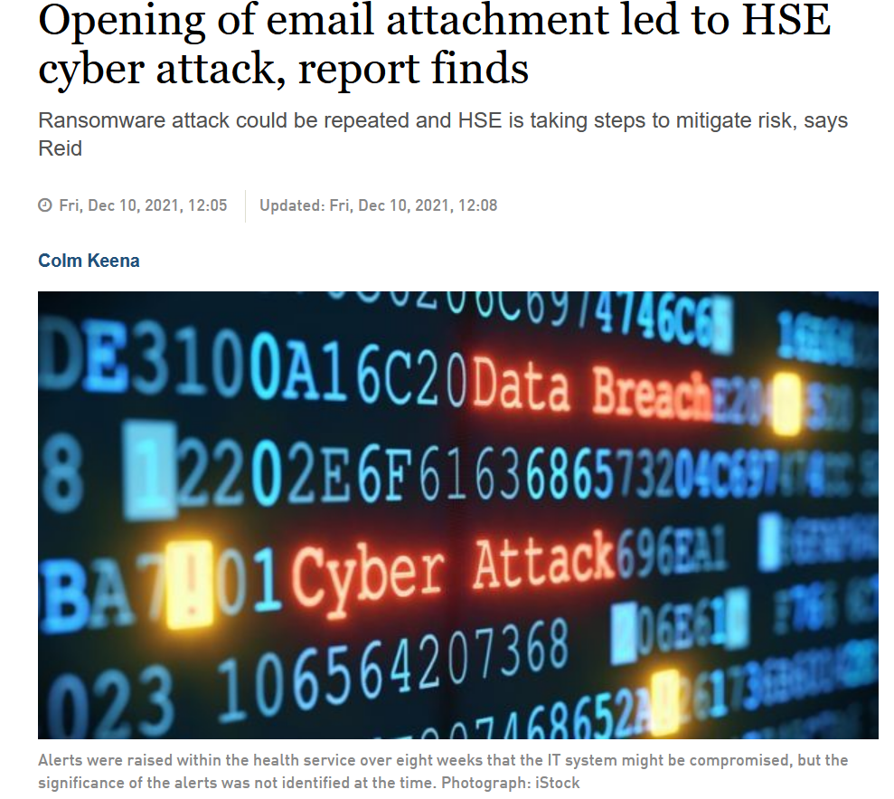
Cyber Security – Examples of attacks
HSE Ireland (2021): Conti ransomware
HSE shut down all IT systems and disconnected networks causing significant disruption to healthcare services.
Reported by HSE management that 80% of the HSE’s environment across corporate IT services, hospitals, CHOs and electronic health records (“EHR”) was encrypted
The independent report commissioned did not deal with whether any ransom was paid but public statements were to the effect that none would and that a criminal gang in Russia was responsible.
Notes:
Report: https://www.hse.ie/eng/services/publications/conti-cyber-attack-on-the-hse-full-report.pdf

Slide 8
Cyber Security – Some high level points
Effective cyber resilience is an interplay between leadership, governance, risk management, technology and threat modelling.
In the context of a breach there are going to be a whole host of stakeholders to deal with and this demonstrates the complexity of the issue from a governance perspective.

Slide 9
Cyber Security – Some high level points
Responsibility for an attack may also be a difficult thing to attribute and Korff for instance, highlights how this can present interesting questions in public international law.
‘[T]here is the problem of attacks being perpetrated by non-state actors reportedly backed by states, in non-declared wars and “asymmetric conflicts”. That problem already existed in the offline world, and there is some law on it10 – but it is particularly pressing in the digital environment, in which attribution of actions – and attacks – to specific, identified actors is often difficult if not impossible. This makes it difficult to know whether, in a particular situation, the rules of war apply to a cyber incident, or not.’
This may be complicated in the context of the complex technology/ infrastructure supply chain.

Slide 10
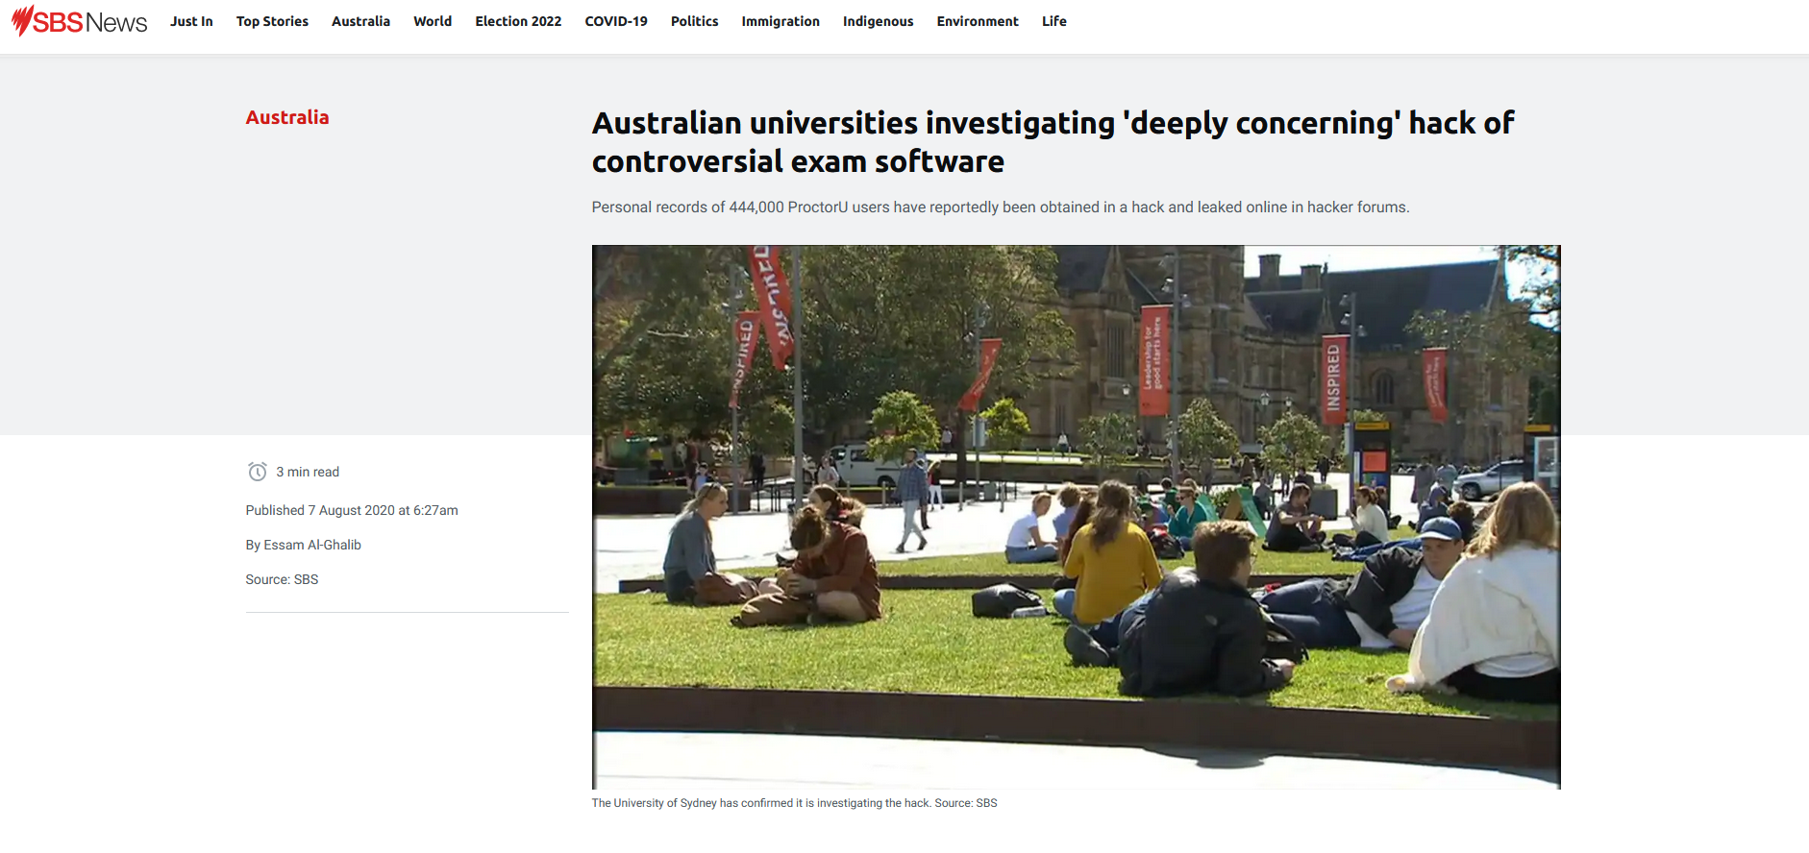
Cyber Security – The problem of supply chains

Slide 11
Cyber Security – Some high level points
Who controls the security risks? (vendors of technological solutions, their supply chain and customers)
How do you divide responsibility? Think about the role of commercial and consumer contracts here for instance.
Complexity is a big issue here.

Slide 12
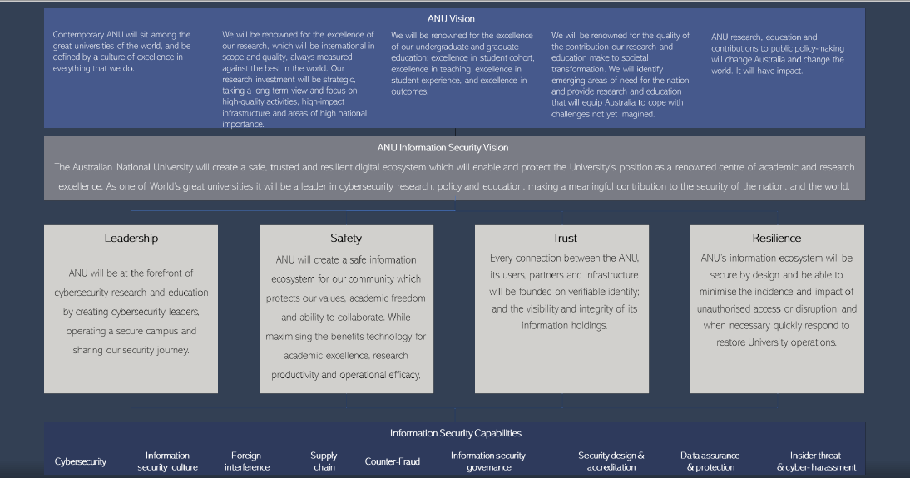
Cyber Security – Some high level points

Slide 13
Cyber Security – Some high level points
An effective cyber security plan involves establishing a security aware culture and it isn’t all about technical solutions
Policies and procedures need to be clear and a focus on improving processes can have a positive impact on behaviour.
It also requires investment.

Slide 14
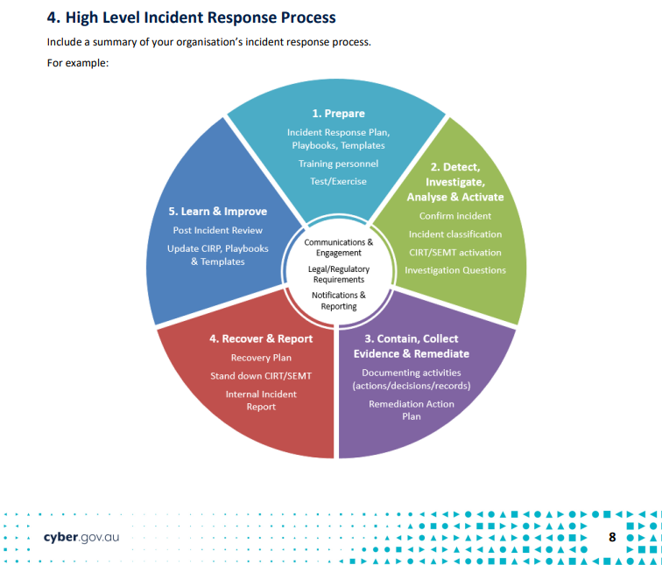
Cyber Security – Some high level points

Slide 15
Do you see any challenges in applying some of these systems and processes?

Slide 16
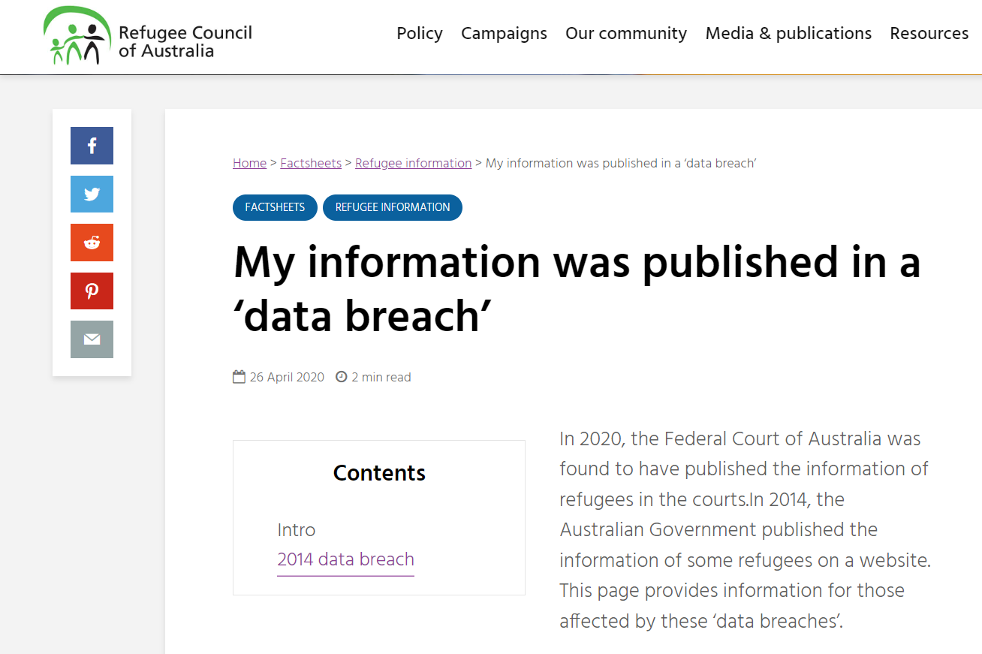
Cyber Security – Some high level points

Slide 17
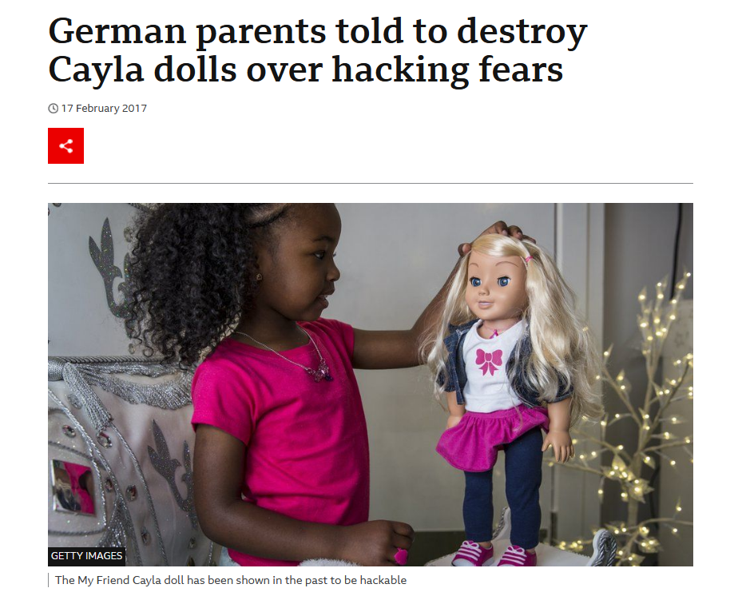
Cyber Security and consumer products

Slide 18



Cyber Security and Children’s Rights
United Nations Universal Declaration of Human Rights
Children have rights because they are humans
UNCRC – distinct subset of human rights
Children are active right holders, because they are children

Slide 19
Cyber Security and Children’s Rights
Underlying goal = right to ‘optimal’ development
Multidimensional “Three P’s”
Protection
Provision
Participation
The regulatory protections for children online (for instance in data protection law) have to attain a balance between protection, participation and provision.

Slide 20
Cyber Security and Children’s Rights
Children’s rights principles:
Development; non-discrimination, best interests of the child; right to be heard
Rights that enable children to reach their fullest potential:
Freedom of thought
School and educational goals
Participation in leisure and play
Privacy
Protection against economic exploitation
…
Rights should be looked at through a digital lens! See: General Comment 25 on Children’s Rights in relation to the Digital Environment

Slide 21
Cyber Security and law enforcement, national security and cyber warfare
Korff describes how law enforcement, national security agencies and other agencies rely on the same techniques as cyber-criminals/cyber-terrorists and that these actions are legitimised through law.
There is nothing unusual about for as for example police powers to enter a premises a detain someone are permitted but only under strict conditions.
Authors such as Korff however, are critical of the controls that exist over the exercising of such powers as they effectively amount of hacking and are therefore, potentially invasive but have been treated different in legislation.
Indeed, Korff in particular points to the blurring roles of what were once very clearly delineated agencies. To clarify, national security agencies gaining more powers and responsibilities to investigate serious crimes such as terrorism and law enforcement gaining more intelligence gathering powers.
Notes:
Korff, Douwe, Harm Caused to Fundamental Rights and Freedoms by State Cybersecurity Interventions (November 28, 2016). Available at SSRN: https://ssrn.com/abstract=3709808 or http://dx.doi.org/10.2139/ssrn.3709808

